Slide 1
UE18CS390A – Project Phase – 1
End Semester Assessment
Project Title : Community detection in dynamic networks.
Project ID : 77
Project Guide : Prof. Sreenath MV
Project Team :
Name | SRN
Mahammad Thufail | PES2201800646
Manne Vasanth | PES2201800425
Purushotham S | PES2201800480
Pulle Manikya Sri Manasa | PES2201800468

Slide 2
Agenda
Introduction and Motivation
Problem Statement
Abstract and Scope
Literature Survey / Existing System
Suggestions from Review – 3
Requirements Specification
Design Approach
Design Constraints, Assumptions & Dependencies
Proposed System / Approach
Architecture
Design Description
Project Progress
References

Slide 3
Introduction and Motivation
Terrorism is a type of collective violence having direct impact on peace, normal routine of a country/community and security and it is also a way to generate fear in civilians using violence.Terrorism is an evolving phenomenon, thus it is vital to provide counter-terrorism operators with tools for the prevention of it.
The main objective of this work is to define an approach aiming at eliciting knowledge on terrorist attack perpetrators by analyzing terror events along the timeline. The idea is to construct a sociogram, i.e., a network of perpetrators, where the nodes represent terrorist groups and the edges represent generic relations occurring between two groups.

Slide 4
Problem Statement
Elicit terrorist group networks from a database of terrorist events, finding most influential node and community detection :
We use rough set approach to understand the composition and evolution of terrorist networks. Later on we will find influential nodes based on neighborhood correlation coefficient. Finally for Community Detection we use Louvain algorithm using locality modularity optimization.

Slide 5
Abstract and Scope
We are using an approach that will allow us to find clusters of similar terror groups using information on their operational characteristics. Specifically, using open access data of terrorist attacks occurred worldwide since 1970, we are trying to build network that includes terrorist groups and related information on tactics, weapons, targets, active regions.
We model this data with each partition joined to the terrorist groups. Later on we will find the most influential group with maximum number of relations between other networks and try to prevent the attacks .Community detection to identify sets of nodes in such a way that the connections of nodes within a set are more than their connection to other network nodes.

Slide 6
Literature Survey
Paper Details | Objective of paper, Techniques/Methods | Advantages | Limitations
Vincenzo Loia, Francesco Orciuoli “Understanding the composition and evolution of terrorist group networks: A rough set approach. ” Paper 2019 | The proposed approach has been demonstrated and evaluated by using a Python implementation of rough set operators (realized by the authors ) and comparing the results to the expert knowledge obtained by the resources provided by the GTD database (START project). | The paper provides an original approach to elicit terrorist group networks from a database of terrorist events by using a similarity function based on rough set theory. The approach has been described and illustrated by providing several illustrative examples. | The lack of a method to automatically deal with time intervals and the lack of a method to automatically analyze the temporal evolution of terrorist groups networks.

Slide 7
Literature Survey
Paper Details | Objective of paper, Techniques/Methods | Advantages | Limitations
Ahmad Zareie, Amir Sheikhahmadi, Mahdi Jalili, Mohammad Sajjad Khaksar Fasaei “Finding influential nodes in social networks based on neighborhood correlation coefficient. ” Paper 2020 | Social networks analysis and mining have recently gained ever-increasing importance with many potential applications in diverse industries. Influence maximization is one of the topics that has attracted much attention in this field. | Important challenge in influence maximization is to find the most influential nodes based on their structural location in the network. | Need to process entire data to find the most influential node.

Slide 8
Literature Survey
Paper Details | Objective of paper, Techniques/Methods | Advantages | Limitations
Mehdi Azaouzi, Delel Rhouma, Lotf Ben Romdhane “Community detection in large‑scale social networks: state‑of‑the‑art and future directions” Paper 2019 | The main goal of this paper is to give a comprehensive survey of community detection algorithms in social graphs. Taxonomy of existing models based on the computational nature and thus in static and dynamic social networks. Comprehensive overview of existing applications of community detection. | The refinement step converge very fast . Very good balance between structural and attribute similarities.Good quality of partition. | Eliminates many interesting communities. The number of communities should be known in advance. Noise sensitivity.

Slide 9
Literature Survey
Paper Details | Objective of paper, Techniques/Methods | Advantages | Limitations
Hamid Ahmadi Beni, Asgarali Bouyer “TI-SC: top-k infuential nodes selection based on community detection and scoring criteria in social networks” Paper -2020 | The TI-SC algorithm selects the infuential nodes by examining the relationships between the core nodes and the scoring ability of other nodes. After selecting each seed node, the scores are updated to reduce the overlap in selecting the seed nodes. This algorithm has efcient performance in high Rich-Club networks. | In this paper, They have proposed an efcient community-based algorithm combined with a scoring measure for selecting top-K infuential nodes. In the TI-SC algorithm, the scoring criterion reduces the overlap of seed nodes, and this leads to the selection of K-node with optimal infuence spread. | Infuence maximization is a classic optimization problem to fnd a subset of seed nodes in a social network that has a maximum infuence with respect to a propagation model. This problem sufers from the overlap of seed nodes and the lack of optimal selection of seed nodes.

Slide 10
Suggestions from Review - 3
The suggestions we got from Review 3 are as follows :
To make use efficient method of calculating similarity to build similarity matrix. Therefore, Overlap Measure method is implemented.

Slide 11
Requirements Specification
NetworkX : For the creation, manipulation, and study of the structure, dynamics, and functions of complex networks.
Igraph : It is a collection of network analysis tools with the emphasis on efficiency, portability and ease of use.

Slide 12
Design Details
Novelty:
The prediction of terrorist network and identifying main actors is an important issue for intelligence and security informatics, and few of the researches lack in this aspect. So we propose a method to analyze social network using some machine learning techniques (ie.,K-Core Concepts). Once the networks are clustred accordingly then we then use methodology based on community detection to determine the relationships of the terrorist node within the same cluster as well as the terrorist nodes from different clusters.
Innovativeness:
The approach that we proposed elicits terrorist group’s networks, finds most influential nodes and temporal evolution of terrorist networks, but it is not an open-source model instead these data are shared with national intelligent management for protecting nation from terrorist threats and implement counter terrorism activity.

Slide 13
Design Details
Performance:
Performance is also the main aspect of this approach, because the approach that we proposed has a better efficiency since we measure it by considering the number of nodes that can instantly access a large number of different nodes through a relatively small number of ties. The nodes are treated as nonredundant contacts.
Maintainability:
We need to use a good ranking methods and algorithms to make sure it is showing right results to the users. We would also assign weights to the nodes so that there will be change in importance of identifying the community accordingly as the time goes on. These ranking methods have to be tested and updated time to time to ensure good working of the tool. The retrieval of results from the underlying search engines is achieved using their respective API’s which are free of cost. Maintenance would be required if their respective policies changes.

Slide 14
Design Details
Reliability:
The algorithm we use is capable of performing operations using the data got from the terrorist database and is producing results in a time which we could think of other tasks to perform. It is reliable for the kind of data we use and the efficient results produced at the end.
Legacy to modernization:
To gain operational efficiencies as per the legacy modernization we are updating and optimizing business systems by enabling graphical access to government agencies who could actually view each community growth and the influential node in a single display graphical view. This makes user achieve their expectations in their experience and getting easily adopted to other newer technology platforms.

Slide 15
Design Details
Application compatibility:
As our project is capable of operating in different operating systems and its environment is also user-friendly, it allow us to automate the process of testing where all the application is tested for their compatibility at once. Enabling auto removing of the features which is not supported by the operating system is achieved to a certain extent.
Resource Utilization:
There is huge data to be processed and most of it are not needed for the kind of results we expect. So we kind of use only the results which has huge impact on terrorist growth and which also needed for the future link prediction among the groups. The community detection almost enables us to know the relation between different communities and their growth over time. So the data is utilized as per our intermediate needs and predictions.

Slide 16
Proposed Methodology / Approach
Understanding the composition and evolution of terrorist group networks: A rough set approach.
Selecting relevant features
Building rough conceptualizations of terrorist groups
Building boundary regions for terrorist groups
Building Similarity matrix
Designing the terrorist groups network

Slide 17
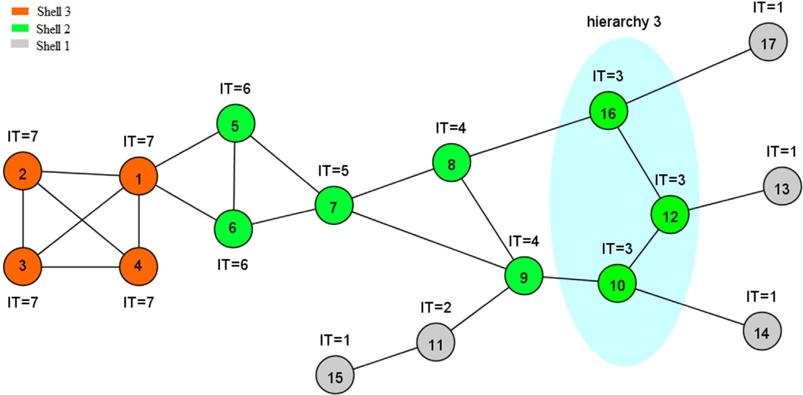
Proposed Methodology / Approach
Finding influential nodes in social networks based on neighborhood correlation coefficient.
In the proposed approach, we consider common hierarchy between a node and its neighbors rather than the number of their common neighbors. To this end, the network is first divided into different parts. Nodes that are removed in the same iterations of the k-shell algorithm can be assumed to be in the same hierarchy.

Slide 18
Proposed Methodology / Approach
Community Detection in social networks : Communities are calculated by maximizing the objective function in a two-step optimization in each one of the iterations.
Louvain algorithm using locality modularity optimization:
In the first step, small communities are formed by optimizing the modularity locally. Only local changes of communities are allowed in this step.
In the following step, nodes belonging to the same community are aggregated in a single node that represents a community in a new aggregated network of communities.
Iteratively these steps are repeated until no increase in modularity is possible with a hierarchy of communities being produced.
Once the original algorithm does not allow the addition or removal of new nodes and edges after obtaining the community structure, a re-computation of the communities starting from an initial network is necessary.

Slide 19
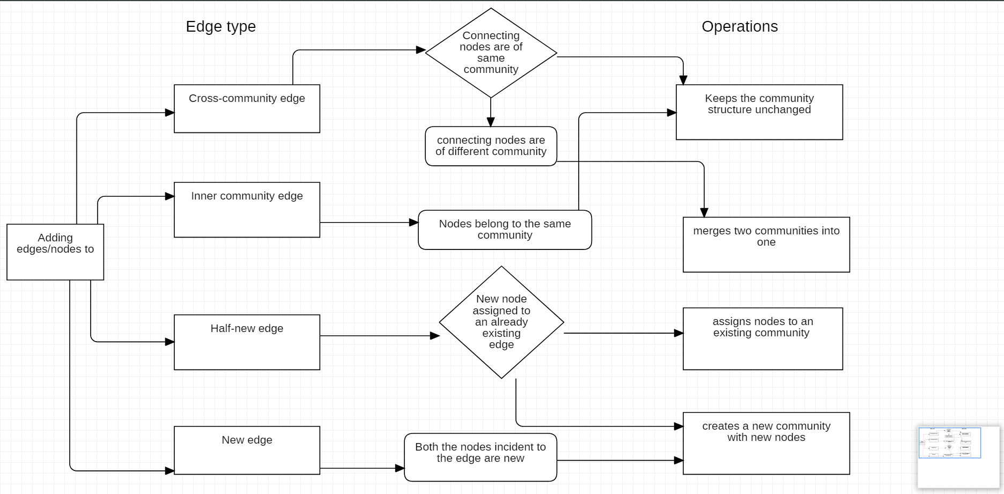
Proposed Methodology / Approach
Adding nodes/edges:

Slide 20
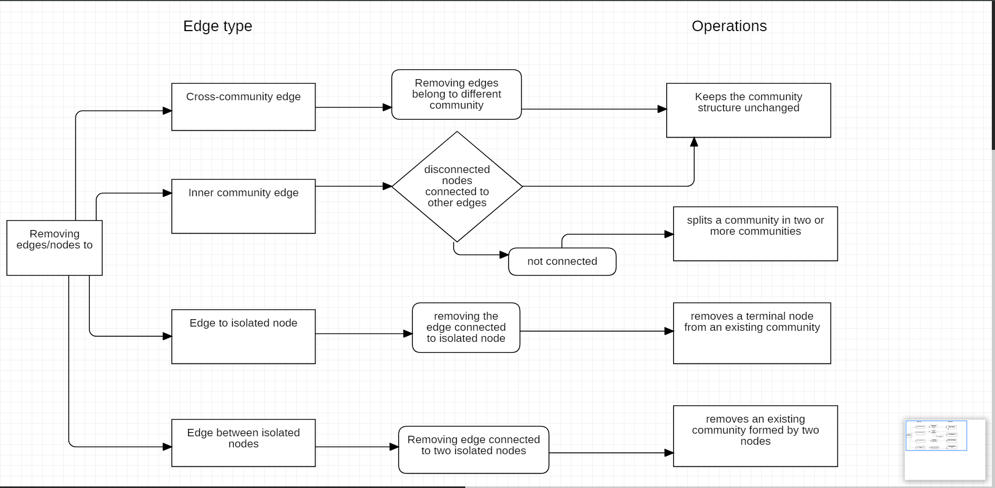
Proposed Methodology / Approach
Removing nodes/edges:

Slide 21
Proposed Methodology / Approach
To enable true dynamic graph community detection, the Louvain Method was modified to support incremental community structure changes when nodes are added or removed from the network.
The quality of communities obtained by the Dynamic Louvain in the incremental network scenario had a slightly higher variance in modularity compared to the original Louvain.
Why this algorithm is better:
Optimization: Our algorithm only performs community detection in the full network only at the first snapshot.
Efficiency: The modified Louvain steps will only compute communities which are affected by addition or removal of nodes/edges.
Stability: In the proposed algorithm, unaffected communities keep unchanged. Therefore, they preserve the same nodes and even the same community id between snapshots.

Slide 22
Project Progress
We have made literature survey and have come up with a proper approach.The algorithm for implementation/execution is decided.
We have completed so far 40% of the project development phase and have started the Implementation round.

Slide 23
Capstone (Phase-I & Phase-II) Project Timeline
March 9 2021
March 25 2021
April 9 2021
Finalising the Algorithm
Literature Survey
Finalising requirements for the project
Discussing and finalising the approach and understanding required technology
Working on part 1 of the project
Timeline on Deliverable-1

Slide 24
Capstone (Phase-I & Phase-II) Project Timeline
June 25 2021
July 15 2021
July 31 2020
Partial implementation of model
Final implementation
Present final system and start working on making a research paper
Submit the project for review and make journal on our implementation of project.
Timeline on Deliverable-2

Slide 25
Conclusion
Since the Proposed Methodology / Approach have algorithms with lesser time and space complexity which performs well, It is expected to provide better results.

Slide 26
References
Understanding the composition and evolution of terrorist group networks: A rough set approach.
Authors : Vincenzo Loia, Francesco Orciuoli
https://www.sciencedirect.com/science/article/pii/S0167739X19307757
Finding influential nodes in social networks based on neighborhood correlation coefficient.
Authors : Ahmad Zareie, Amir Sheikhahmadi, Mahdi Jalili, Mohammad Sajjad Khaksar Fasaei
https://www.sciencedirect.com/science/article/pii/S0950705120300630
Community detection in large‑scale social networks: state‑of‑the‑art and future directions
Authors : Mehdi Azaouzi, Delel Rhouma, Lotf Ben Romdhane
https://www.sciencedirect.com/science/article/pii/S0020025517310101

Slide 27
References
TI-SC: top-k infuential nodes selection based on community detection and scoring criteria in social networks
Authors : Hamid Ahmadi Beni, Asgarali Bouyer
https://www.researchgate.net/publication/333197917

Slide 28
Thank You

